Slide 1

SUMO Traffic Simulation
MIDTERM PROJECT REPORT
Team Members:
Matthew Blank & Alain Shekano & Dylan Blevins

Slide 2
The Project
Description:
Creating a Traffic simulation using traffic flow data collected from a real-world intersection that compares its effectiveness against a round-a-bout created in the same space to see which optimizes traffic flow better.
Objectives:
Determine an "optimum" traffic structure for directing vehicles in a high-volume intersection
Find an "optimum" stop light conditions for this intersection given our simulation.

Slide 3
Background
According to Federal Highway Administration:
Traffic light and roundabout are a safety concern for the environment, economy and pedestrians.
Constant development of roads:
New road are being constructed
Existing roads are being modified
There have been many other research papers and models done especially by the National Highway Traffic Safety Association.
According to WSDOT, roundabout reduced..
Crashes: 75%
Pedestrian Collisions: 40%
Fatality Collisions: 90%
Overall collisions: 37%

Slide 4
Project Plan
Gather pre-existing traffic data
Two Simulations in SUMO (each run using pre-existing traffic data)
Four-way traffic control
Round-a-bout
Result Analysis
Collect multiple simulation data
Compare results

Slide 5
Expected Data
Avg # of cars at given lane
Avg wait time at a light
Avg vehicle velocity
Avg vehicles passing through the intersection per unit time frame

Slide 6
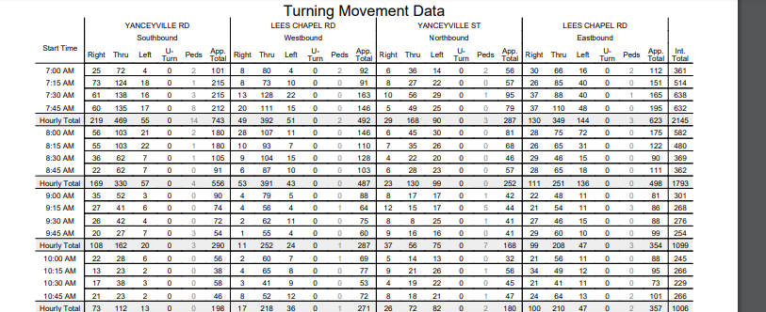
Data

Slide 7
Technical Description
Simulations construction tools
SUMO – click and place simulation editing interface that allows users to manipulate .xml files
Visual manipulation of routes, intersection
.xml files: Manipulate the SUMO environment through code
Python language
Ex: A program that spawn 20,000 vehicles
SUMO GUI : an environment to initiate the simulation
With controls such Play, pause, step forward
Notes:
Technical description (e.g. architecture, component diagram, experimentation workflow etc); basic and optional functionality (or experiments); expected features, output and results. Describe the platforms (e.g. languages) and tools used.

Slide 8
Accomplish Work
Accomplished Work:
We have produced the four way intersection and the simulation on it for traffic flow.
We have produced the prototype roundabout.
We have found data for comparison.
We have worked out what SUMO commands are required for data collection

Slide 9
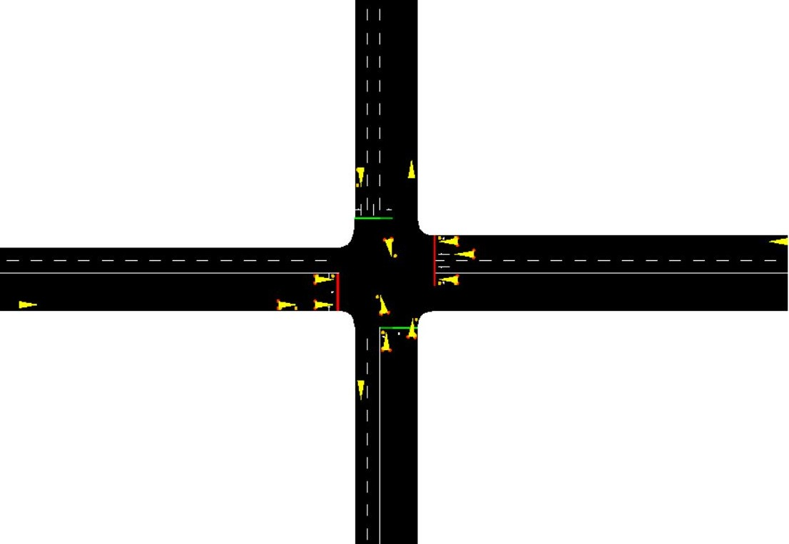

Status
This is the final version of the intersections layout
This line shows the traffic light and its current state
This yellow arrow is a vehicle that is currently moving down a route.

Slide 10
Effort
Member​ | Activities​ | Hours​
Alain​ | Traffic light timing​ | 2​
Matthew​ | Data collection​ | 1​
Dylan​ | Routes creation​ | 1.5​
Dylan​ | Road layout​ | 4​
Matthew​ | Road layout​ | 6​
Alain​ | Round-a-bout​ | 2​
 | Construction (not finished)​
Matthew​ | SUMO set-up for team use​ | 4​
Dylan​ | Traffic Junction Creation​ | 1​
Dylan​ | Vehicle Spawning​ | 2​
Matthew​ | Vehicle Spawning​ | 2​

Slide 11
Lessons Learned
What Went Right:
Data Gathering -> Simulation production – All tasks were completed without any alterations.
What Went Wrong:
Layout creation (turning lanes/route placement) -> length and lane(turning) placement issues – these were challenges that halted our progression for a little bit, but we ultimately solved our problems.
Nothing
What we would do differently:
Complexity – adding unnessary complexity (Unusual intersection shape) created these "hiccups" that slowed progression
Simplicity – using a simplier design, since this is our first using SUMO, would have saved a day of work. (Go big or go home though right?)

Slide 12
Expected Forthcoming Activities
Activities to do | How to do it | When
Collect data on four-way intersection | Though SUMO commands | By 4/6/2020
Create Final roundabout simulation | Through SUMO | By 4/10/2020
Collect Data on roundabout | Through SUMO commands | By 4/18/2020
Start Report & Presentation | Overleaf Latex & Google Slides | By 4/19/2020
Finish Report & Presentation | Overleaf Latex & Google Slides | BY 5/2/2020

Slide 13
References
[1] “Roundabout benefits,” WSDOT, 14-Sep-2018. [Online]. Available: https://www.wsdot.wa.gov/Safety/roundabouts/benefits.htm. [Accessed: 28-Jan-2020].
[2] ACS Engineers, “Roundabouts vs Traffic Lights,” ACS Engineers, 22-Aug-2016. [Online]. Available: https://www.acsengineers.com.au/2016/08/22/roundabouts-vs-traffic-lights/. [Accessed: 28-Jan-2020].
[3]“Intersection Safety - Safety: Federal Highway Administration,” Safety. [Online]. Available: https://safety.fhwa.dot.gov/intersection/innovative/roundabouts/. [Accessed: 28-Jan-2020].

